Slide 1
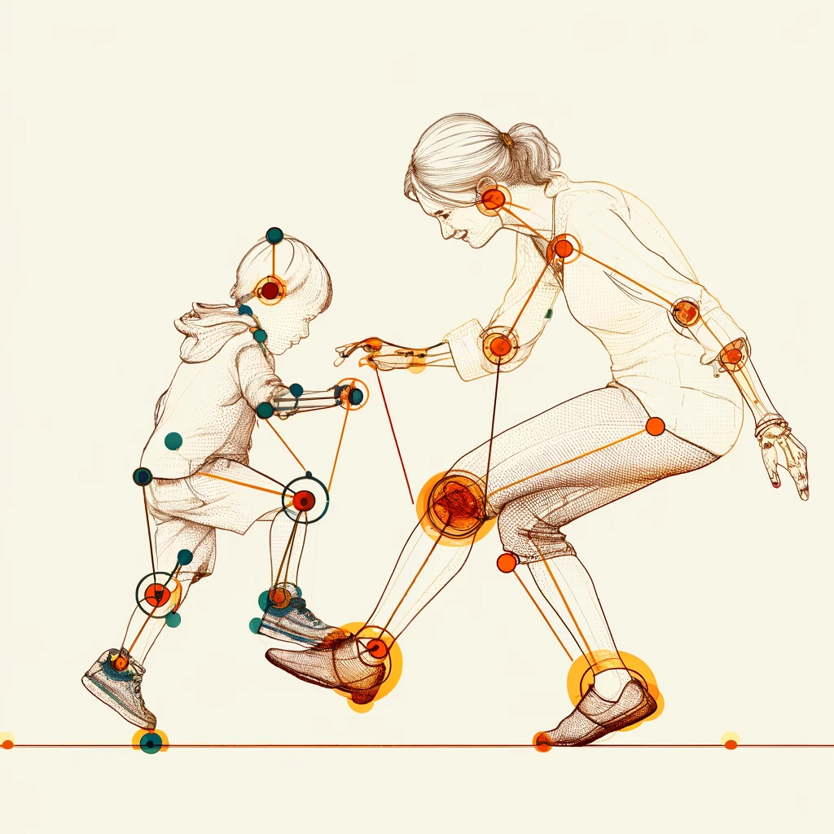
Evaluation of Interpersonal Synchronization between Individuals based on Video Recording
Dana Betesh 315015958
Semion Rodman 319636395
Notes:
מודל!

Slide 2
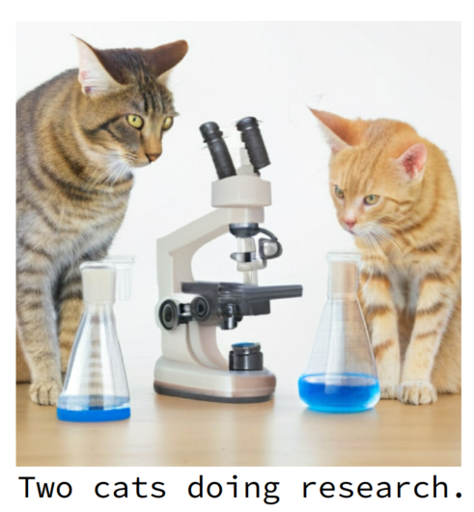
Introduction to Text-to-Image Generation
An advanced AI technology that transforms written descriptions into detailed, often photorealistic, visual images
Employs deep learning models to interpret and visualize textual content as images
Represents a significant leap in AI's ability to understand and bridge human language and visual perception

